Slide 1
Brenda Lewis
Is God a Warmonger ?

Slide 2
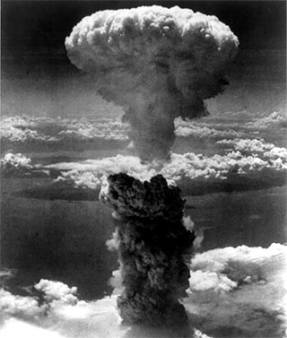
‘It has always appeared to me more
satisfactory to look at the immense amount
of pain and suffering in this
world as the inevitable result of the natural sequence
of events... rather than from the direct
intervention of God.’ Charles Darwin
Notes:
He is not alone. Many people would rather attribute death, famine, disease and war to natural causes, rather than attribute responsibility to God.

Slide 3
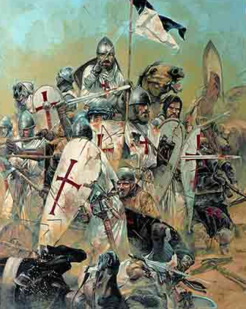
The Charges
Religion causes bitter wars
Christianity is especially responsible
The God of the Old Testament, the tribal God, was a bloodthirsty warmonger, unrelated to Christ

Slide 4
9 / 11 !!!
Notes:
These charges have become increasingly common since 9/11.

Slide 5
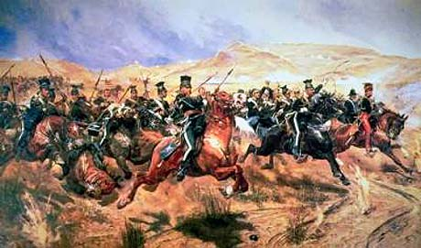
19th Century
‘Forward the Light Brigade,
Charge for the guns,’ he said
Into the valley of death
Rode the six hundred.
Notes:
In the 19th century, war was good.

Slide 6
19th Century
‘Forward the Light Brigade,
Charge for the guns,’ he said
Into the valley of death
Rode the six hundred.
Theirs not to make reply
Theirs not to reason why
Theirs but to do and die
Into the valley of Death
Rode the six hundred

Slide 7
19th Century
‘Forward the Light Brigade,
Charge for the guns,’ he said
Into the valley of death
Rode the six hundred.
Theirs not to make reply
Theirs not to reason why
Theirs but to do and die
Into the valley of Death
Rode the six hundred
[Canon to the right of them
Canon to the left of them
Canon in front of them
Volleyed and thundered.]

Slide 8
19th Century
‘Forward the Light Brigade,
Charge for the guns,’ he said
Into the valley of death
Rode the six hundred.
Theirs not to make reply
Theirs not to reason why
Theirs but to do and die
Into the valley of Death
Rode the six hundred
Canon to the right of them
Canon to the left of them
Canon in front of them
Volleyed and thundered.
When can their glory fade
O the wild charge they made!
All the world wondered
Honour the charge they made
Honour the Light Brigade
Noble six hundred!
Notes:
Note the honour and glory.

Slide 9
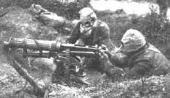
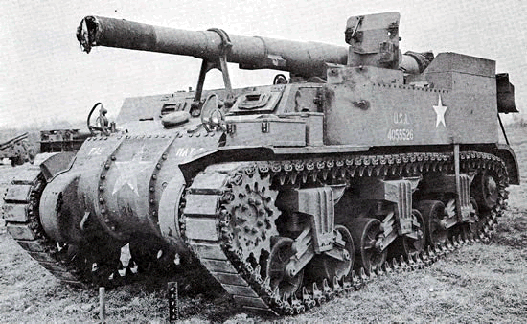
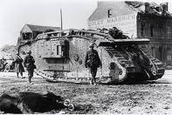
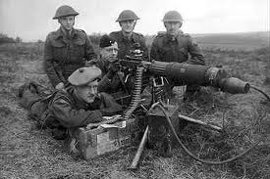
20th Century
What passing bells for these who die as cattle?
Only the monstrous anger of the guns
Notes:
In the 20th century, war is bad – a reaction to the meaningless massacres of World War I. The century took its tone from Wilfrid Owen, who wrote of the ‘pity of war’.

Slide 10
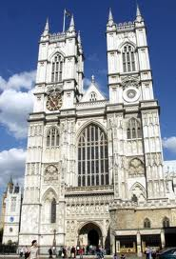
20th-21st Century
Gracious Lord oh bomb the Germans
Spare their women for thy sake
And if that is not too easy
We will pardon thy mistake
But, gracious Lord, whate’er may be,
Don’t let anyone bomb me!
Notes:
In the 21st century, we are confused about war, like this woman in John Betjeman’s ‘In Westminster Abbey’.

Slide 11
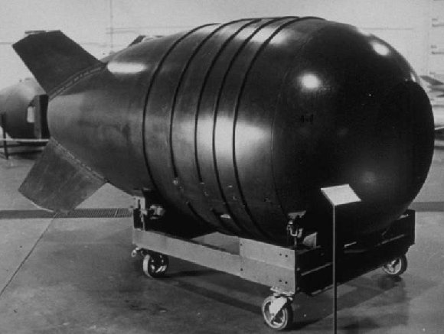
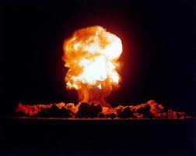
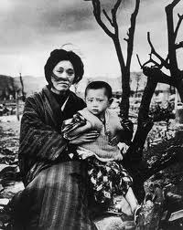
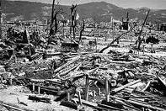
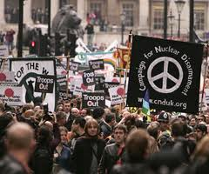
WORLD WAR I
15-65 million dead
WORLD WAR II
40-72 million dead
HIROSHIMA & NAGASAKI
100,000 dead

Slide 12
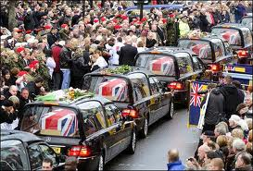
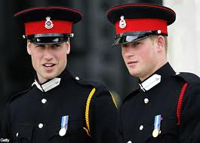
?
GOOD
or
BAD ?
Notes:
We tend to feel the people in Wootton Bassett were right to honour the dead and think more highly of the Princes for their willingness to serve in a war zone.

Slide 13
RELIGION CAUSES WAR - therefore ban religion ! e.g.
Protestant – Catholic in Northern Ireland
Hindu – Muslim in India & Kashmir
Catholics (various) – Muslim in Philippines, Timor, Algeria, Nigeria, Bosnia, Kosovo, Cyprus, Eritrea, Nagorno-Karabakh, Lebanon, Chechniya
Jews – Muslims in Middle East
Confucians & Buddhists – Muslims in Singapore & Malaysia
Notes:
Religion is a major cause of war. So is trade, but we don’t call for a ban on trade.

Slide 14
What do people mean by “Religion cause war” ?
DISCUSS

Slide 15
Some answers
Give up religion then there won’t be war.
Secular societies are safer than religious ones.
War is bad.
Religion is a dangerous hobby which you have no right to be indulging in.
If we give up religion, so will everyone else – like unilateral disarmament.
Non-Christian is safer.
I am frightened by religious – Islamic extremism (Islamic, because other religions are less likely to attack us).
THE DOMINANT EMOTION IS ?
Notes:
Fear

Slide 16
What are the assumptions behind those assumptions? Would Christians dispute them? e.g. It is more important not to die, than anything else?

Slide 17
Some answers
God doesn’t know what he is doing.
God has no right to judge.
God has a right to judge, but not to use human beings to carry out those judgments.
God doesn’t know how dangerous religion is.
Religion is relatively unimportant and can be got rid of if necessary.
The most important thing is personal safety – death is the worst thing.

Slide 18
What wars and martial attacks are people thinking of when they say this?
9/11, 7/7
IRA
Israeli-Arab
Al Quaeda
Afghanistan, the Taliban
Iraq
Muslims think primarily of the Crusades.
Religion is a factor in all of these, but not the only factor.
Did we go to war with Afghanistan or Iraq to oppose Islam and/or to impose Christianity?

Slide 19
So is God a Warmonger ?
Define WAR
= Sustained fighting, more than a skirmish, more than a raid, more than a single battle. In this talk war is taken to be a sustained series of battles or campaigns, between at least two nations or peoples, fought with weapons and tactics and ending either with the complete subjugation of one side, or with a peace treaty.

Slide 20
What is a warmonger?
= Someone who engages in war because he enjoys it or gets some advantage out of it, careless of suffering.
Notes:
Officially a warmonger is a mercenary, but people making this charge mean something more like this definition.

Slide 21
It will be my task today to show:
that although God sometimes requires one nation to fight against another nation, to go to war, he does not do so without just cause.
That in all his work there is mercy, even in war.
The mercy does not dilute the judgment, but operates to rescue some.
Notes:
There are many wars recorded in the Old Testament. The battle for Canaan alone stretched for 450+ years, from Moses to David.

Slide 22
Moses’ final address to Israel Deuteronomy 7:1-6 and 22-26
‘When the LORD your God brings you into the land ....and drives out before you ... seven nations larger and stronger than you... you must destroy them totally. Make no treaty with them and show them no mercy. Do not intermarry with them ... for they will turn your sons away from following me to serve other gods and the LORD’s anger will ...quickly destroy you...Break down their altars, smash their sacred stones, cut down their Asherah poles and burn their idols in the fire. For you are a people holy to the LORD.
He will give their kings into your hand and you will wipe out their names from under heaven...The images of their gods you are to burn in the fire. Do not covet the silver or gold ... for it is detestable. Do not bring a detestable thing into you house or you, like it, will be set apart for destruction. Utterly abhor and detest it, for it is set apart for destruction.’
Notes:
I have chosen three of the worst cases, the ones which cause people trouble.

Slide 23
Rules for war
There were two types of war which the LORD helped Israel to fight:
war with their neighbours
war with the Canaanites whom Israel was required by God to oust from that land
& two types of rules

Slide 24
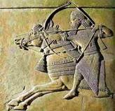
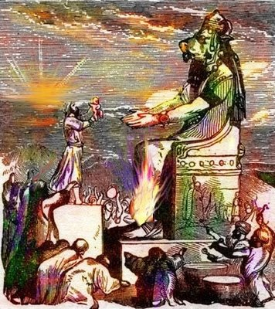
Rules for war with Canaanites Deuteronomy 20:16-18
“In the cities of the nations the LORD your God is giving you as an inheritance, do not leave alive anything that breathes. Completely destroy them ... as the LORD your God has commanded you. Otherwise they will teach you to follow all the detestable things they do in worshipping their gods, and you will sin against the LORD your God.”

Slide 25
Jericho and Ai
Jericho
After Israel took Jericho and the walls fell flat, They devoted the city to the LORD and destroyed with the sword every living thing in it – men and women, young and old, cattle, sheep and donkeys... Then they burned the whole city and everything in it. (Joshua 6:20-21, 24)
Ai
Two chapters further on, they reach the nearby city of Ai. ‘Then the LORD said to Joshua, ‘Go up and attack Ai...You shall do to Ai and its king as you did to Jericho and its king.’ When Israel had finished killing all the men of Ai in the fields and in the desert where they had chased them, and when every one of them had been put to the sword, all the Israelites returned to Ai and killed those who were in it... So Joshua burned Ai and made it a permanent heap of ruins, a desolate place to this day.’ (Joshua 8:1-2, 24-28)
Notes:
Could this be our loving heavenly Father telling them to do these things?

Slide 26
What did God say?
You will wipe out their names from under heaven.
The Canaanite idols were totally detestable to God.
Israel must destroy all religious places
Canaanites practise sorcery and spiritism, divination and witchcraft – kill them all.
Why?
‘Otherwise they will teach you to follow all the detestable things they do in worshipping their gods.’

Slide 27
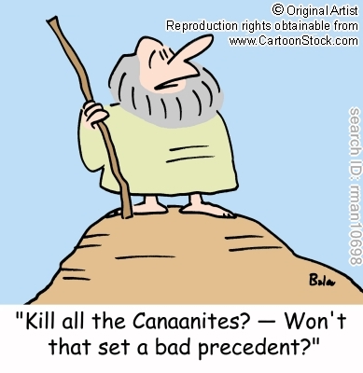
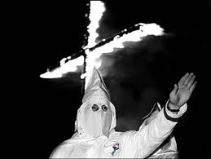
God taught his holy people to massacre.
Many unsavoury groups have justified their own killing because of them – e.g. Ku Klux Klan.
This is not something to defend, but to explain.

Slide 28
God, King Saul & the Amalekites
‘Attack the Amalekites and totally destroy everything that belongs to them. Do not spare them; put to death men and women, children and infants, cattle and sheep, camels and donkeys.’ I Samuel 15.
Saul obeyed most of this but not all. Samuel the prophet confronted him.
‘The LORD anointed you king over Israel. And he sent you on a mission saying, Go and completely destroy those wicked people, the Amalekites; make war on them until you have wiped them out.’
Saul tried to justify himself, but Samuel replied, ‘Because you have rejected the word of the LORD, he has rejected you as king.’

Slide 29
Herem Mrx
It involved separation, destruction and devotion, in the sense that everything was given over to destruction. The city and its spoil were devoted to God for destruction by the sword, if they were living, and otherwise by fire. It involved destruction of goods and property and smiting with the sword. Longman says it is connected with consecration and worship. It was the offering of the conquered people and their possessions to the Lord. Because the people were unclean, being brought into the presence of God meant that they must be killed.
There was to be no covenant, no marriage and no mercy.
If they are left alive, they will cause Israel to follow their gods. They and their worship must be exterminated. Not just the men, but the women too. Sometimes the Canaanite women enticed the people of Israel by sexual sin to worship their gods.
Their worship must be exterminated.
Only Israel was authorised to carry out herem as a righteous act.
Notes:
These are instances of herem, a complete removal of wickedness by war and subsequent destruction. God is completely thorough. He cannot live with sin.

Slide 30
Herem was necessary because
The hardness of men’s hearts, often further hardened by God himself. They were way past being able to repent.
Joshua 11 tells us that Joshua carried out Herem on 31 Canaanite kings. ‘It was the Lord himself who hardened their hearts to wage war against Israel, so that He might destroy them totally.’ Joshua 11.20
Because of the need to protect Israel against idolatry.
To act as a picture of Final Judgment and a warning of it.
31 cities exterminated. What can we say?
Notes:
There was to be no covenant, no marriage and no mercy. Only Israel was authorised to carry out herem.

Slide 31
CS Cowles is horrified !
‘No psalms were composed celebrating the extermination of the Canaanites. No hymns extol the slaughter of the Amalekites. No holidays remember the Conquest. Jewish and Christian parents hide their children’s eyes from the herem passages - a huge embarrassment to sensitive believers, an outrage to unbelievers.’ He says it is alien to the nature of God who revealed himself in Jesus as ‘not wanting anyone to perish but everyone to come to repentance.’
How can we answer this charge?

Slide 32
Merrill:
‘The war was conceived, commanded, executed and brought to a successful conclusion by God. God is holy and his people must be holy.’ They must not touch idols.
‘Idolatry is the proclamation of the existence of supernatural powers that co-exist with the God of creation.’

Slide 34
Some of the varied reactions of people in the church alarmed by these passages:
It is wrong for any nation to exercise genocide in the name of God against another nation.
Only ancient Israel could do so and only when God commanded it.
Only God who gives life can take life.
God grants to rulers the sword of justice, but not the sword of aggression.
Christians can participate in war, but only a Just War.
The church has no political boundaries, she does not raise armies or fight battles with weapons, her warfare is spiritual, not fleshly.

Slide 35
Cowles:
thinks God’s actions here seem arbitrary and sometimes indefensible. It concerns him that Canaanite genocide was executed by fallible and sinful Israelites just as prone to idolatry as the people they destroyed. He just cannot accept that God would do this.
He says, ‘No babies will be consigned to hell, no-one will be thrown into the lake of fire because of race, nationality or religious affiliation.’
These passages on herem provoke a strong reaction and are meant to. They are pictures of final destruction.
People have asked, If God is so holy, then why was it only Canaan who was destroyed?
The nations opposing Israel deserved their fate. But so did all other nations then and so do all nations today. Even Israel deserved the same fate.

Slide 36
Meredith Kline:
‘The punishment for sin is death. We should not be amazed that God ordered the death of the Canaanites. Rather we should stand amazed that he lets any of us live. The destruction of Canaan is a preview of the final judgment.
Peter Craigie:
‘The judgment of God is the other face of the coin which is the mercy of God.’
What mercy is here? - God even tells Israel to show no mercy.

Slide 37
Are there any mitigating factors at all?
God does not rush to judgment and destruction.
He did not cause Abraham, Isaac or Jacob to execute any judgment on the Canaanites. He waited until the Canaanites had become really wicked. He says to Abraham that their iniquity is not yet complete. Genesis 15.16.
He did not destroy Israel until not only had they become deeply involved in idolatry, but they had persecuted the prophets who warned them again and again of the risks they ran if they continued to pollute the land, and even, Ezekiel tells us, the temple itself, with their idols.

Slide 38
2. God was ready to save the one who would come completely over to him, even under herem.
a) He saved Rahab the prostitute in Jericho.
b) In earlier judgments he had rescued the few – Noah and his family in the flood, Lot and his daughters in the destruction of Sodom.

Slide 39
God’s judgment was not arbitrary, but specific
a) He wanted Israel to completely destroy the cities of Canaan, but to give cities outside the opportunity to make peace. b) He did not allow them to attack Edom, descended from Jacob’s brother Esau. c) He did not allow them to attack Ammon or Moab, descended from Lot.

Slide 40
4. His judgment on the Canaanites, like his judgment on Sodom, was justified and righteous
They worshipped the Baals and Asherahs and indulged in all kinds of filthy practices.

Slide 41
God is impartial.
God is even handed and impartial in his righteousness and holiness, as Joshua discovered.

Slide 42
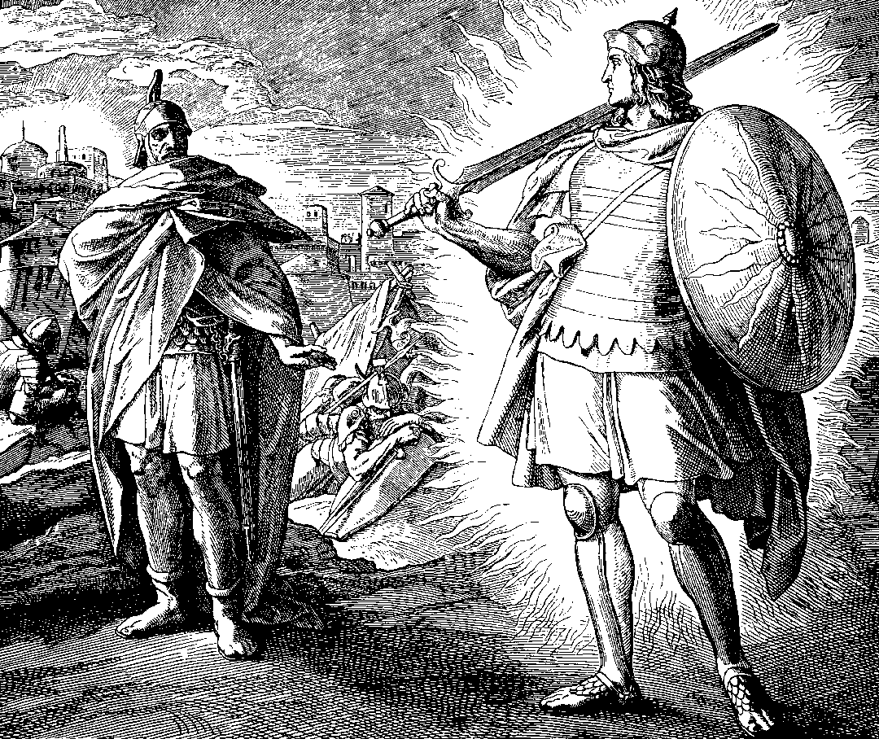
‘When Joshua was near Jericho, he looked up and saw a man standing in front of him with a drawn sword in his hand. Joshua went up to him and asked, ‘Are you for us or for our enemies?’ ‘Neither,’ he replied, ‘but as commander of the army of the LORD I have now come.’ Joshua 5:13-14
Notes:
Over and over again Israel turned to idols and God gave them over to their enemies until they abandoned the idols and cried out toe God. In the end the herem was against Israel. It was destroyed by Assyria.

Slide 43
‘All this took place, because the Israelites had sinned against the Lord their God ... they worshipped other gods... they set up sacred stones and Asherah poles ... they bowed down to the starry hosts, and they worshipped Baal. They sacrificed their sons and daughters in the fire. They practised divination and sorcery ... so the Lord was very angry with Israel an removed them from his presence. 2 Kings 17.
The southern kingdom of Judah in its turn was destroyed by Babylon. The people were put to the sword, the temple was destroyed and the city of Jerusalem burned with fire. The king carried many survivors into exile in Babylon. The writer of Chronicles tells us why.

Slide 44
‘They mocked God’s messengers, despised his words and scoffed at his prophets until the wrath of God was aroused against his people and there was no remedy.’ 2 Chronicles 36:16ff.
a) Jeremiah, one of prophets who was badly treated for telling them the truth, lamented over the destroyed city of Jerusalem. He writes with unexpected tenderness, ‘Men are not cast off by the Lord for ever. Though he brings grief he will show compassion, so great is his unfailing love. For he does not willingly bring affliction or grief to the children of men.’ Lamentations 3:31ff.
b) In the New Testament, we see the same truth expressed when Jesus, foreseeing the destruction of Jerusalem 40 years later, and knowing he could so easily have rescued the people and the city, laments over it:

Slide 45
‘O Jerusalem, Jerusalem, you who kill the prophets and stone those sent to you, how often I have longed to gather your children together, as a hen gathers her chicks under her wings, but you were not willing. Look, your house is left to you desolate.’
Matthew 23.37ff.

Slide 46
Jesus regarded his Father God as the author of the Old Testament, ‘so that what it said, God said.’ He quoted the Old Testament as his authority all the time.
He used the Old Testament scriptures to explain things about himself, for example when he spoke to the two disciples going to Emmaus on the day of his resurrection: ‘Beginning with Moses and all the Prophets, he explained to them what was said in all the Scriptures concerning himself.’ Luke 24.25-7.
Peter connects the God of the patriarchs with the Father of the Lord Jesus in his sermon in Acts 3. He says: ‘The God of Abraham, Isaac and Jacob ... has glorified his servant Jesus.’
Notes:
There has to be judgment in the end, but God does not want to bring it. He is a God of mercy and a God of judgment. Some think God in the Old Testament is a different God. This is not so. How do we know?

Slide 47
God told Moses about himself:
‘The Lord, the compassionate and gracious God, slow to anger, abounding in love and faithfulness, maintaining love to thousands and forgiving wickedness and rebellion and sin.’
Exodus 34.6-7
Notes:
The Lord Jesus came to explain more fully who God is, not to change to a different God. God’s participation in history has always been for man’s salvation.

Slide 48
Differences between OT and NT
Hebrews says God has made the old covenant obsolete.
In the OT they could hate their enemies, but not in the NT.
Moses allowed divorce, Jesus taught against it.
The NT changes occur because it the law of of grace has higher standards.
Jesus repeatedly stated he did not come to abolish the Law and Prophets, but to fulfil them.

Slide 49
Further differences
Wesley says Jesus removed the ceremonial parts of the law, but kept the moral law.
Jesus declared all foods clean when Peter was told to eat unclean animals in his vision – he could also mix with Gentiles.
Council of Jerusalem retained three out of hundreds of ceremonial laws for Christian Gentiles.

Slide 50
Zechariah 9.10
He spoke of a future king whose coming would be with humility and whose message would be of peace, yet ‘his dominion shall be from sea to sea, and from the River to the ends of the earth.’
In the OT, God is God of the nation state of Israel. In the NT, Jesus is king not just of Israel but the whole earth.
Expanded meaning for ‘the kingdom of God’.

Slide 51
Spiritual warfare
NT writers never think of military conquest as a way of furthering the gospel.
Merrill says herem warfare is, ‘a war against spiritual darkness and wickedness’ that involved ‘a struggle against the realms of evil on a massive, transcendent level.’
The fight is always against Satan, whether on physical or spiritual level.

Slide 52
Spiritual Warfare (2)
Jesus defeated the powers and authorities, not by killing, but by dying says Longman.
The nation state always need to use violence to defend itself.
In his death, Jesus receives violence.
God the warrior becomes God the crucified.
Jesus took back territory held by Satan, but achieved it spiritually, by defeating principalities and powers.
He won not by killing, but by dying.
It is this which changes out perception of the world and of God.

Slide 53
Spiritual warfare (3)
Paul says, ‘We do not wage war as the world does. The weapons we fight with are not the weapons of the world. On the contrary, they have divine power to demolish strongholds.
2 Corinthians 10:3-5
Paul tells us to take the whole armour of God, but he means salvation, righteousness, truth and the weapon is the word of God.
Ephesians 6

Slide 54
Final Judgment
The person who teaches most about hell in the bible is Jesus.
In Matthew chapters 10-13 he speaks of it over and over again.
He teaches and warns repeatedly about a final judgment.
This is not surprising because John and Paul tell us Jesus has been appointed our Judge.

Slide 55
Judgment
Jesus says, ‘Do not suppose that I have come to bring peace to the earth. I did not come to bring peace but a sword.’
We think of Jesus as Prince of Peace, and interpret that almost as a pacifist.
We overlook his talk of throwing the wicked into unquenchable fire.
We overlook his many images of darkness, weeping, gnashing of teeth, regret and anguish.
This was what Jesus came to save us from.

Slide 56
Wrath
Romans tells us to ‘consider therefore the kindness and sternness of God.’ Romans 11:22
‘Whoever believes in the Son has eternal life, but whoever rejects the Son, will not see life, for God’s wrath remains on him.’ John 3:26
NB: The wrath does not descend on him. We are born as children of wrath. It’s nothing new.
If we are all by nature children of wrath, then the gospel is really good news for us.

Slide 57
Herem in NT
‘You ought to live holy and godly lives as you look forward to the day of God ... That day will bring about the destruction of the heavens by fire, and the elements will melt in the heat.’ 2 Peter 3:11-12
Herem in OT was judgment on the wicked and warning for everyone else to repent.
Collapse of the Tower of Siloam – the people who died were not more wicked than others, but this was a warning for everyone else to repent.

Slide 58
Jesus as Warrior
‘Coming in the clouds’ is a military picture from Daniel which Jesus repeatedly uses.
‘In the future you will see the Son of Man, sitting at the right hand of the Mighty One and coming with the clouds of heaven.’ Matthew 26:64
The angels are ‘the heavenly host’ - massed armies.
Paul talks of Jesus’ ascension in military language – as in a Roman triumph procession.

Slide 59
War, judgment and NT writers
Pervasive NT warnings of final judgment and war.
Jesus talks of it in all the gospels.
He tells many parables which end in destruction and eternal fire.
Paul talks of it, e.g. In his address in Athens.
Hebrews urges us not to refuse God’s salvation. If the wicked in the OT did not escape wrath, ‘how much less we, if we turn away from him who warns us from heaven?’ Hebrews 12:25

Slide 60
God did not even spare the angels when they sinned; he did not spare the ancient world when he brought the flood, or Sodom and Gomorrah, and he knows both how to rescue godly men (such as Noah and Lot) from trials and to hold the unrighteous for the day of judgment. 2 Peter 2.4-9
Peter says people deliberately forget that the world was once destroyed by water in the Great Flood, by God’s word and that ‘the present heavens and earth are reserved for fire, being kept for the day of judgment and destruction of ungodly men ... the heavens will disappear with a roar; the elements will be destroyed by fire...That day will bring about the destruction of the heavens by fire, and the elements will melt in the heat. (But in keeping with his promise we are looking forward to a new heaven and a new earth, the home of righteousness). 2 Peter 3.3-13.

Slide 61
‘With justice he judges and makes war .... The armies of heaven – were following him. Out of his mouth comes a sharp sword with which to strike down the nations.’ An angel calls to the birds to eat the carrion flesh of kings, generals and mighty men ... and the flesh of all people, free and slave, small and great.’ Revelation 19.11-21
‘Then the Lord will go out and fight against those nations, as he fights in the day of battle. Then the Lord my God will come and all the holy ones with him. The Lord will be king over the whole earth. On that day there will be one LORD and his name the only name.’ Zechariah 14
Notes:
Revelation contains many images of destruction: ‘the wine of God’s wrath’, ‘the smoke of their torment’, ‘the second death’, ‘the lake of fire.’ Jesus ‘will tread the winepress of the fury of the wrath of God the almighty.’

Slide 62
The God who executed herem against the Canaanites is the same God who will execute judgment at the end of time.
This judgment will involve destruction of the heavens, the earth, and all at enmity with God.
‘It will make the most bloddy warfare ... Of the OT seem like children’s bedtime stories.’ Cowles.

Slide 63
We must not overlook the truth
God has rescued Christians from the coming wrath.
There is no condemnation for those in Christ.
Note that Revelation 19:11-15 talks of Jesus as one who ‘judges and makes war... From whose mouth comes a sharp sword with which to strike down the nations.’

Slide 64
Christians need to believe in the judgment:
Czeslaw Milosz (Polish poet who experienced both Nazi and Communist rule) said it was not religion that was the opiate of the people, ‘but the huge solace of thinking that our betrayals, greed, cowardice, (and) murders are not going to be judged.’
Keller comments, ‘It is not belief in a God of judgment that leads to a brutalised society, but loss of belief in a God of judgment.’
The Bible does not glorify war. It shows that the ideal state is peace. ‘They will beat their swords into ploughshares and their spears into pruning hooks. Nation will not take up sword against nation, nor will they train for war any more.’ Micah 4.3

Slide 65
Pacifism
The early church fathers were mostly pacifists. They did not want soldiers admitted to the church.
Tertullian held that the love of enemies is the ‘principal concept of Christianity.’
He was uncompromising with regard to war: ‘There is no agreement between ... the standard of Christ and the standard of the devil ... one soul cannot be due to two masters, God and Caesar.’
Rome felt this attitude undermined state security.

Slide 66
NT and pacifism
There is no condemnation of the military as such in the NT.
John the Baptist tells soldiers to show repentance by doing their job righteously. He does not tell them to lay down their arms.
Jesus does tell Peter to put up his sword, but he had earlier told them to bring swords with them. He also said he could have asked God for 12 legions of angels.

Slide 67
Augustine
Augustine witnessed the sack of Rome by Christian barbarians and agreed Christian pacifism had undermined Roman security.
He proposed the Just War theory:
No unnecessary violence
No needless destruction
No looting
No large-scale massacres
No acts of vengeance or reprisal.

Slide 68
Just War
Moral limits on:
resort to war, (jus ad bellum)
conduct of war(jus in bello)
resolution of war (jus post bellum) - e.g. having a careful exit strategy, making a fair treaty and so avoiding the injustice of something like the Treaty of Versailles which contributed to WWII.
proportional response
immunity for non-combatants
not prolonged beyond reasonable hope of success
legitimate authority, like a UN resolution
a just cause
a right overall aim
do more good than harm
NB - this would have applied to herem wars too.
Notes:
This theory has been worked on throughout the centuries. Here is a more modern version.

Slide 69
Recently
It is currently difficult to make the theory work.
1990-2001, 57 armed conflicts in 45 different places. All but 3 were internal wars.
1945-1992, 30 armed conflicts with 20 million deaths. 29 of the conflicts were within state borders.

Slide 70
Christian Realism
Reinhold Niebuhr in 1940s-50s: a man-made kingdom of heaven is not possible because of the innately corrupt tendencies of society. Power must be balanced by power. Christians must balance evil power by using political power for good.
Niebuhr’s ‘emphasis on sin startled my generation brought up on optimistic convictions of human innocence and perfectibility. But nothing had prepared us for Hitler and Stalin, the Holocaust, concentration camps and gulags.’ Schelsinger: New York Times, 2002

Slide 71
Summary
Adam and Eve brought us all under the wrath of God.
God warned Adam that sin brings death.
‘Under the wrath’ means all are condemned to death, but God is merciful and allows man a measure of life.
God executed judgments on mankind – e.g. The Flood, Sodom, Canaanites.
These are pictures and warnings of final judgment.
Herem reflects God’s holiness and justice, which cannot be separated from his love, mercy and long-suffering.
Jesus is both lamb and judge.
[NB War between Israel and its neighbours showed more mercy]

Slide 72
Summary 2
God in the OT is a God who used war to execute judgment and who helped Israel defend itself against aggressors.
Jesus is compassionate, but most teaching on hell in NT is from Jesus.
NT teaches that Jesus will return with armies of angels, in glory, to judge the world.
In the end, the heavens and the earth will be destroyed and replaced.

Slide 73
Summary 3
Jesus did not fight or kill, but allowed himself to be killed – and so changed the world.
Disciples modelled their behaviour on his.
Church warfare is spiritual warfare.
Most Christians now believe the Church may not take up arms in the name of Christ, but that Christians may fight for their country in a just war.
When Christ returns there will be war and probably a physical one.

Slide 74
Christopher Hitchens who had personal experience of wars of religion in several countries: ‘Religion poisons everything, it aggravates racial and cultural tensions and that religion makes arguments into cosmic battles.’
(NB He overlooks the millions killed by totalitarian and atheist regimes in the last hundred years).
Alister McGrath: ‘The greatest intolerance and violence of ... the 20th century were practised by those who believed that religion caused intolerance and violence.’

Slide 75
Christianity can still be politically powerful
Desmond Tutu and others avoided bloodshed in South Africa by working for reconciliation.
Totalitarian regimes have sometimes been undermined and brought down by Christians co-operating in large numbers to put the teachings of Christ into practice – to forgive and to do good. (e.g Polish Christians reacting to the murder of Jerzy Popieluszko)
When Christians are involved in wars, they can pursue them righteously – as Augustine noticed the ‘unusual clemency’ of the Christian barbarians who sacked Rome.

Slide 76
Are we remaking God in our image?
Have we invented a God we are comfortable with?
Here is the real God of our fear and worship, one who loves us utterly, who is compassionate and slow to anger, who does not desire the death of a sinner, but desires that all men come to repentance

Slide 77
Bibliography
‘City of God’, Augustine, trans. JWC Wand, OUP: London, 1963
‘The reason for God’, Timothy Keller, Hodder & Stoughton: London, 2009
‘The Enigma of Evil’, John W Wenham, Zondervan: Grand Rapids, 1985
‘Show Them No Mercy’, ed. Stanley N Gundry, Zondervan: Grand Rapids, 2003.
‘The Problem of War in the Old Testament’, Peter C Craigie, Eerdmans: Grand Rapids, 1983
‘New Dictionary of Christian Ethics and Pastoral Theology’, ed. David J Atkinson, David H Field, IVP: Leicester, 1995
‘New Dictionary of Biblical Theology, ed. TD Alexander, Brian S Rosner, IVP: Leicester, 2000.
‘A Textbook of Christian Ethics’, Robin Gill, T&T Clark: Edinburgh, 1997

